Slide 1
Book Library

Slide 2
Description
It is a library data base attached with picture and information about books like (name , author , publisher , book price , department ) .
It is enables us to count and organize books .

Slide 3
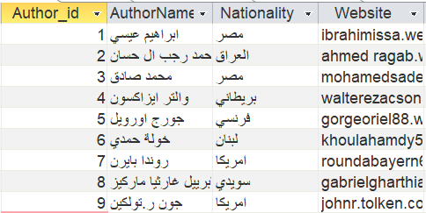
Tables :
Author : enter the data of author .

Slide 4
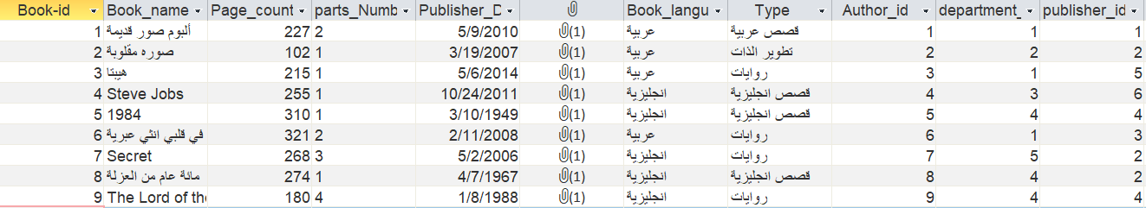
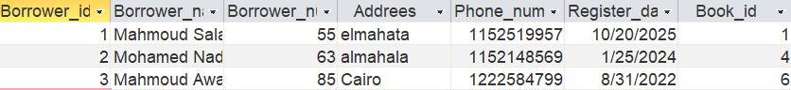
Book : enter the data of the book like type , name …..
Borrower : enter the data of the borrower like address , number…

Slide 5
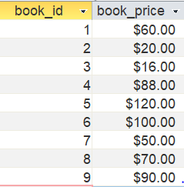
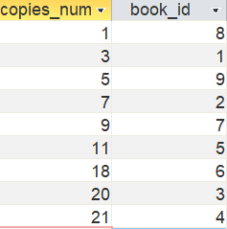
Book price : enter book price
Copies : enter the number of copies per book

Slide 6
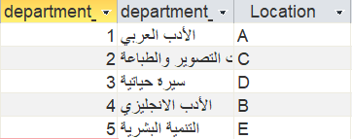
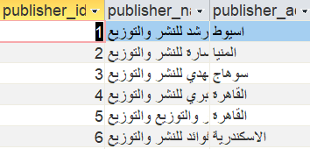
Department : enter the data of department .
Publisher : enter the data of publisher .

Slide 7
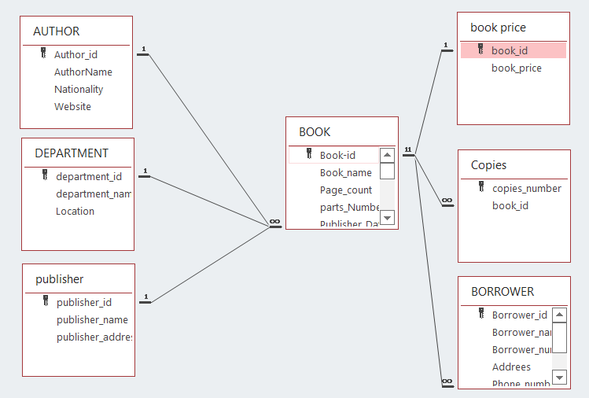
Relations (ERD)
The relation between (Author , department , publisher ) -----> (book) is one to many.
The relation between (book) -----> (book price) is one to one.
The relation between (book) -----> (copies , borrower) is one to many.

Slide 8
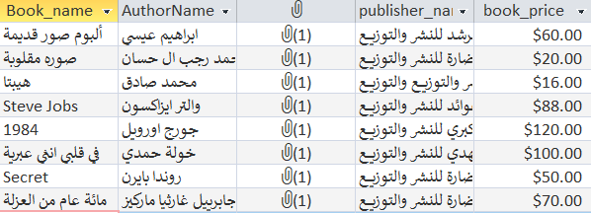
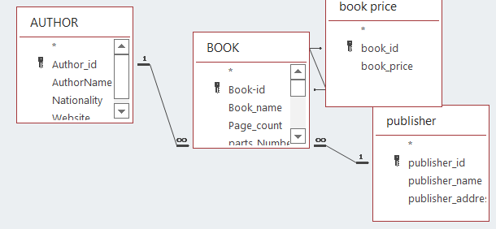
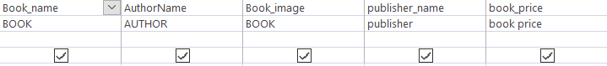
Queries
Author book : it is queries collect ( Book_name , AuthorName ,Book_image ,publisher_name ,book_price ) .

Slide 9
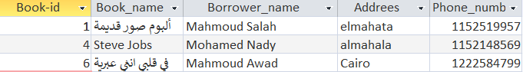
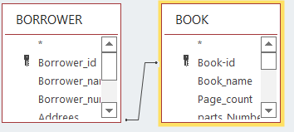
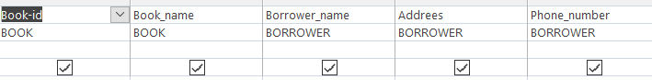
Queries
Book Borrower : it is queries collect ( Book_name , Book_id ,Borrower_name,Adrees,phone_number) .

Slide 10
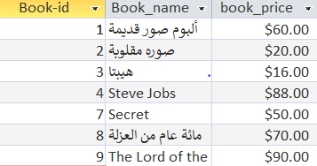
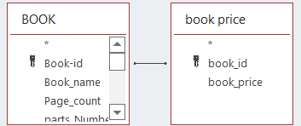
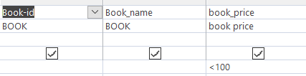
Queries
Book price : it is queries collect ( Book_name , Book_id ,book_price) .

Slide 11
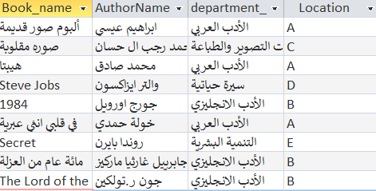
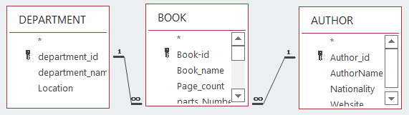
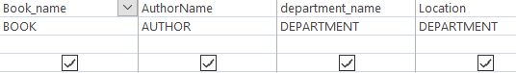
Queries
Book department : it is queries collect ( Book_name , AuthorName ,location,department_name) .

Slide 12
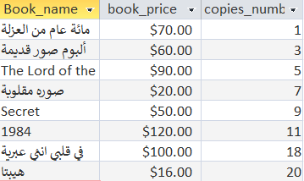
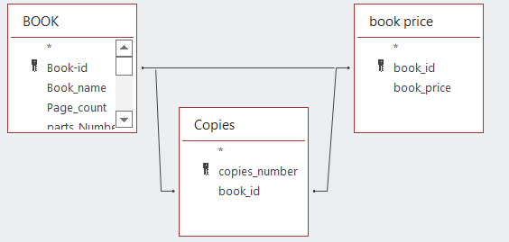
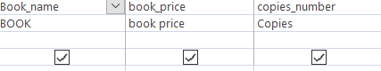
Queries
Book copies : it is queries collect ( Book_name , copies_number ,book_price) .

Slide 13
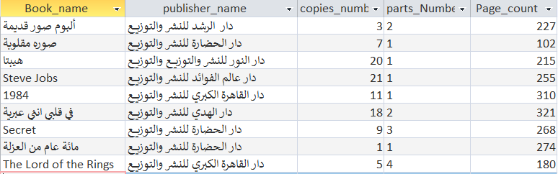
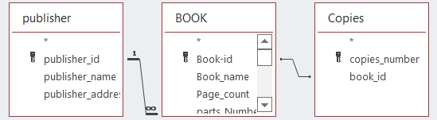
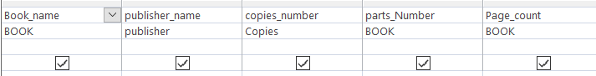
Queries
Publisher book : it is queries collect ( Book_name , copies_number ,publisher_name, parts_Number , Page_count) .

Slide 14
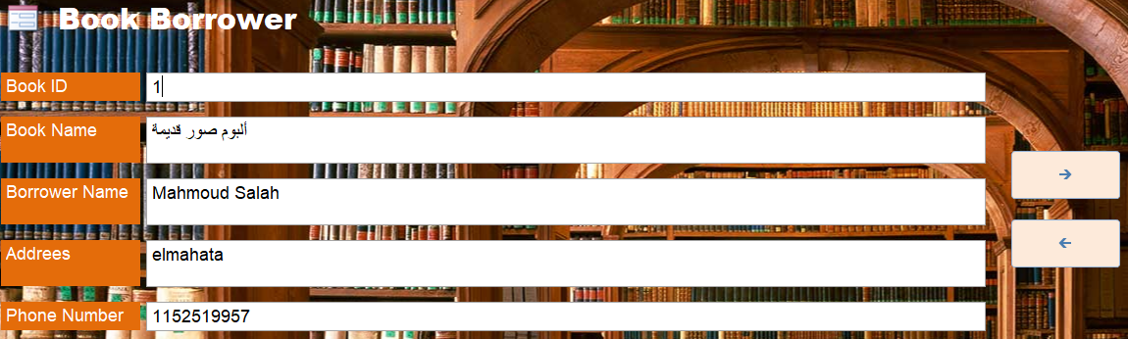
Forms
Book borrower :
next
pervious

Slide 15
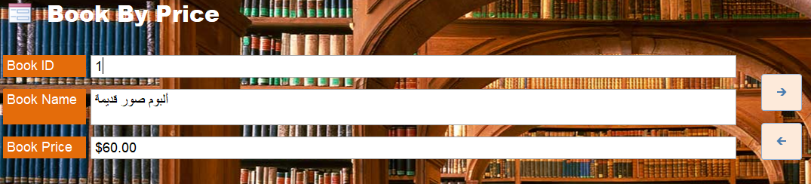
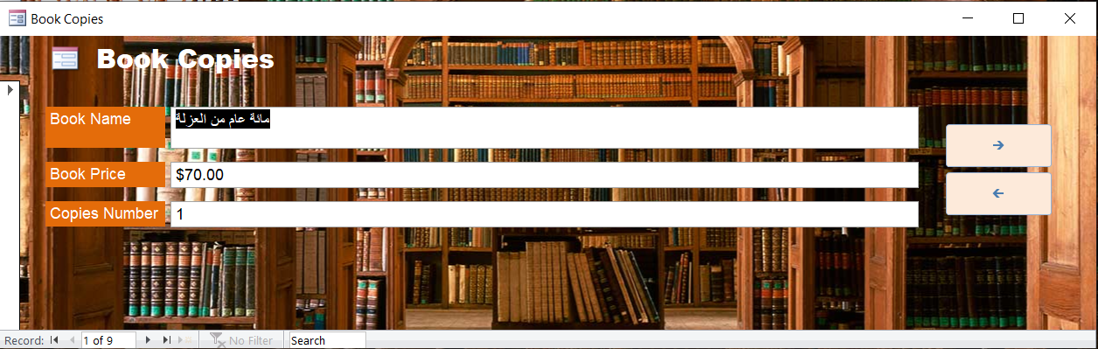
Forms

Slide 16
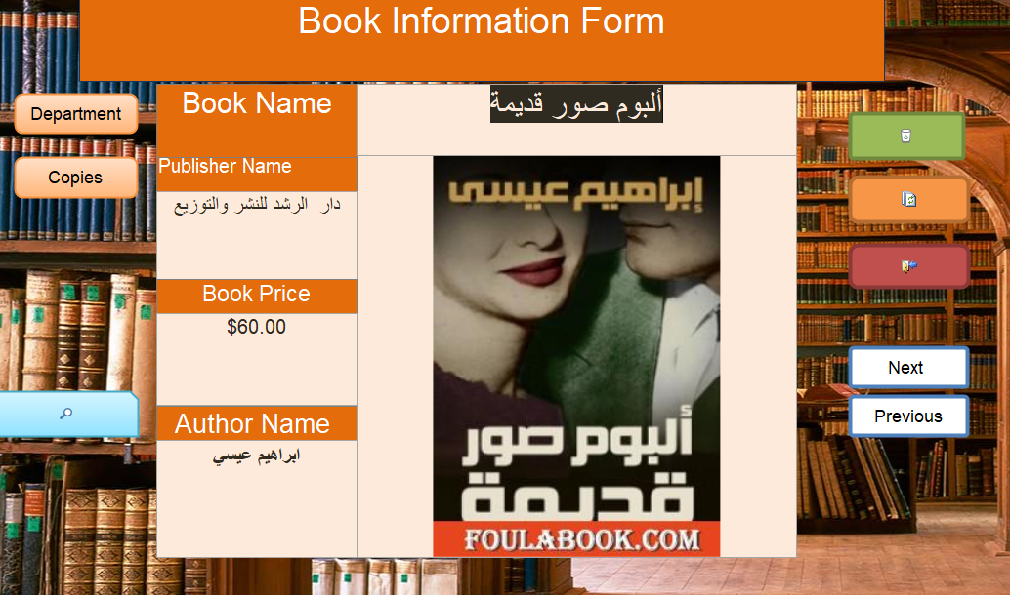
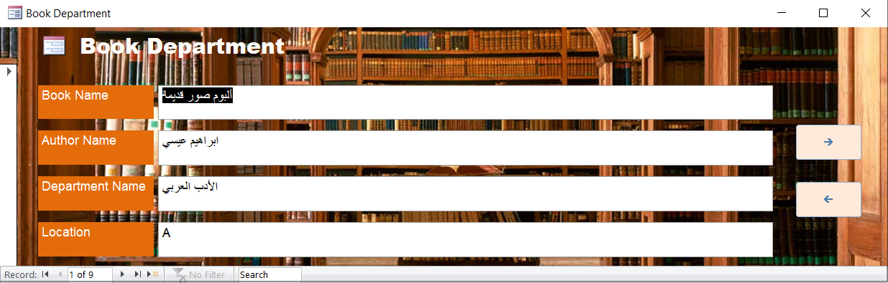
Forms

Slide 17
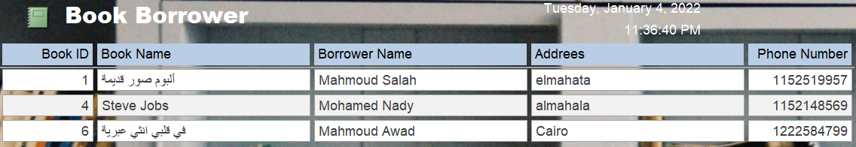
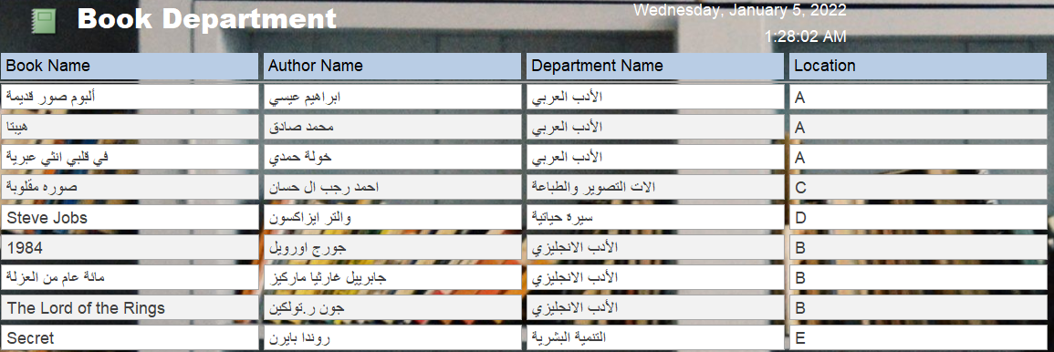
Reports

Slide 18
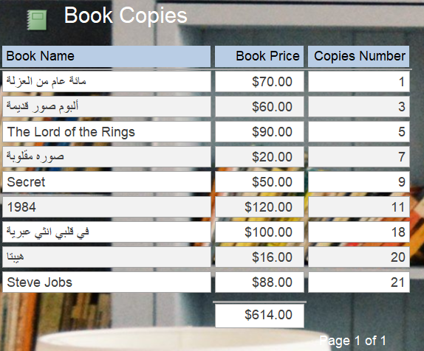
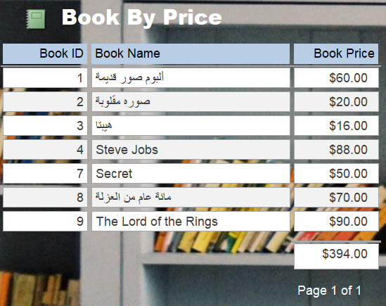
Reports

Slide 19
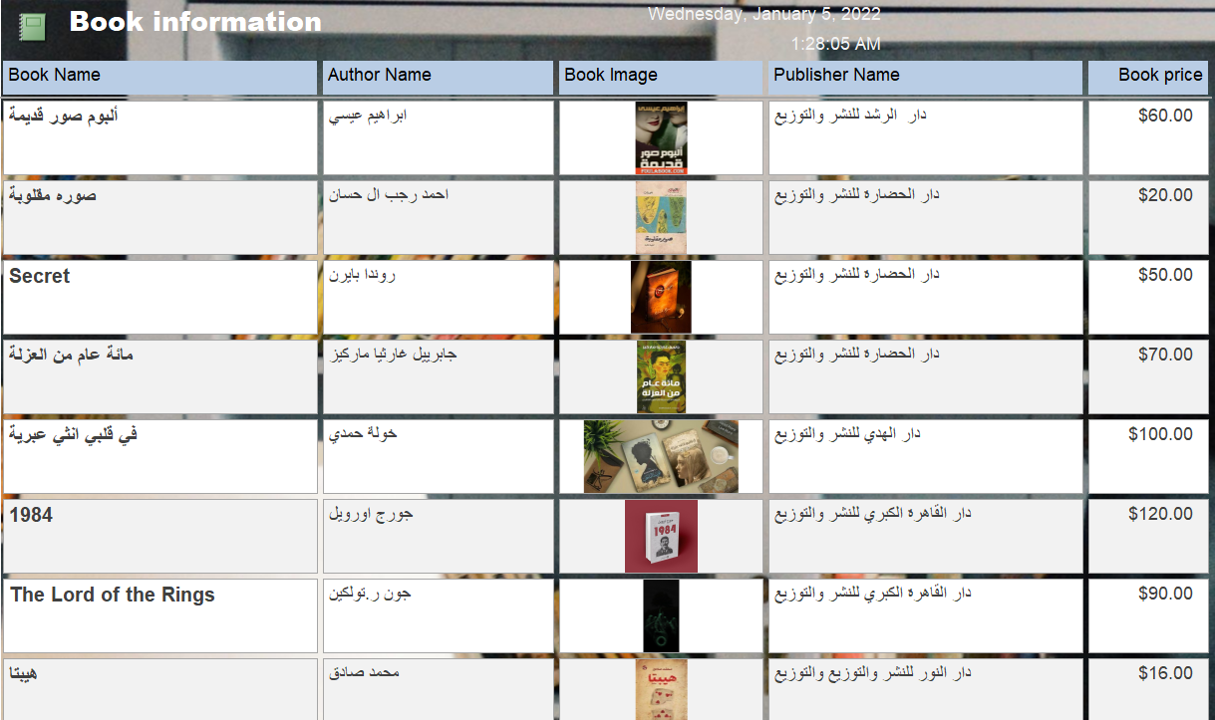
Reports
Contain information of books

Slide 20
End
Under supervision of
Ibrahim El-Semman
Team members
“ Mahmoud Ayman Hashim – Mahmoud Saber Atyaa –
Mahmoud Hussein Mohamed -Mahmoud Salah Abd elaty - Mohamed Mahmoud Ahmed -Mahmoud Nady Mohamed“
…Thanks…

